Slide 1
Flower Species Classification
Roll No. 1901154
Name: Rahul Soni

Slide 2
1.
Problem Definition

Slide 3
Image Classification task using different machine learning algorithms with the help of python
To come up with some machine learning models which can classify flowers into the correct class among the eight different given classes.
Problem comes under the category of supervised learning

Slide 4
Dataset Description
Eight different classes of flowers with Eighty images in each class is given
Given classes
Colis Foot
Daffodil
Daisy
Dandelion
Fritillary
Snowdrop
Sunflower
Tigerlily

Slide 5
2.
Literature Survey

Slide 6
A Visual Vocabulary for flower Classification
~ Maria-Elena Nilsback, Andrew Zisserman
In this paper, the researchers have developed and optimize a nearest neighbor classifier architecture that distinguish categories which have significant visual similarity or to overcome the ambiguities that exist between flower categories
Observations
They conclude that in their larger dataset(OXFORD 17) color feature perform better than shape and texture and texture perform very poorly.
Source: https://www.robots.ox.ac.uk/~vgg/publications/2006/Nilsback06/nilsback06.pdf

Slide 7
Automated flower species detection and recognization and from digital images
~ Aalaa Albadarneh and Ashraf Ahmad
In this paper researchers have used region growing method for segmentation and different features are used combinely. Such as for color, RGB and HSV,for texture GLCM and Wavelet transform. For shape SIFT and HOG methods are used. SGD classifier is used for classification
Observations
They obtained the recognition accuracy result of 92% by using SGD classifier
Source: http://paper.ijcsns.org/07_book/201704/20170421.pdf

Slide 8
Automated Flower Classification over a Large Number of Classes
~ Maria-Elena Nilsback, Andrew Zisserman
They compute feature like local shape/texture, the shape of the boundary, the overall spatial distribution of petals, and the colour with SVM classifier on OXFORD 102.
Observations
An improvement on performance found, from 55.1% for the best single feature to 72.8% for the combination of all features. So combining features will give better results than using single features in case of flower species recognization
Source: https://www.robots.ox.ac.uk/~vgg/publications/2007/Nilsback07/nilsback07.pdf

Slide 9
Feature Extraction

Slide 10
Features are the information or list of numbers that are extracted from an image . These are real valued numbers (integers, float or binary). There are many features but in case of flower images are listed below
Global Feature Descriptors
These are the feature descriptors that quantifies the image globally. Some common among them are:
Color : Color channel Statistics (Mean, Standard Deviation) and histogram
Shape: Hu Moments, Zernike Moments
Texture : HaralickTexture, Local Binary Patterns
Concatenating the above features a single global feature vector is formed.This approach is used in this project
Local Features Descriptors
There are the feature descriptors that quantifies the local regions of the image. Some of them are:
SIFT (Scale Invariant Feature Transform)
SURF (Speeded Up Robust Features)
ORB (Oriented Fast and Rotated BRIEF)
BRIEF (Binary Robust Independent Elementary Features)

Slide 11
3.
Results

Slide 12
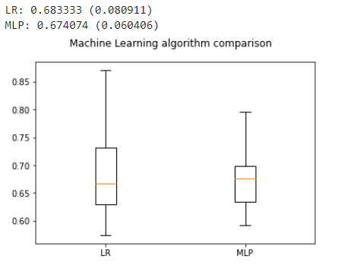
Used Training Models:
Used k fold cross validation score to get the best model among the available models
Logistics Regression
Mean score: 0.683333
Multi layer Perceptron
Mean score: 0.714815
Box plot for k fold cross validation score

Slide 13
Class-wize precision , recall and overall accuracy using Multi Layer Perceptron

Slide 14
ColisFoot
Precision: 0.75
Recall: 0.75
Daffodil
Precision: 0.60
Recall: 0.43
Daisy
Precision: 0.83
Recall: 0.71
Dandelion
Precision: 0.50
Recall: 0.67
Fritillary
Precision: 0.83
Recall: 1.00
Snowdrop
Precision: 0.70
Recall: 1.00
Sunflower
Precision: 0.33
Recall: 0.40
Tigerlily
Precision: 0.86
Recall: 0.55

Slide 15
Overall test Accuracy of the dataset (on test samples)
Total inputs: 60
Correctly predicted: 41
Overall Accuracy: 0.68

Slide 16
Confusion Matrix (MLP)
 | ColisFoot | Daffodil | Daisy | Dandelion | Fritillary | Snowdrop | Sunflower | Tigerlily
ColisFoot | 9 | 0 | 0 | 1 | 1 | 0 | 1 | 0
Daffodil | 1 | 3 | 0 | 1 | 0 | 1 | 1 | 0
Daisy | 0 | 0 | 5 | 0 | 0 | 2 | 0 | 0
Dandelion | 0 | 1 | 0 | 4 | 0 | 0 | 1 | 0
Fritillary | 0 | 0 | 0 | 0 | 5 | 0 | 0 | 0
Snowdrop | 0 | 0 | 0 | 0 | 0 | 7 | 0 | 0
Sunflower | 0 | 1 | 0 | 1 | 0 | 0 | 2 | 1
Tigerlily | 2 | 0 | 1 | 1 | 0 | 0 | 1 | 6
AV
PV
AV : Actual values PV: Predicted values

Slide 17
Prediction on some random images (which are separated from the dataset before training)using Multilayer Perceptron

Slide 18
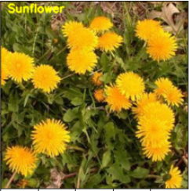
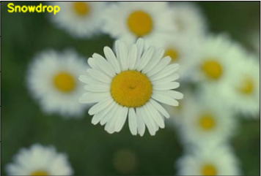
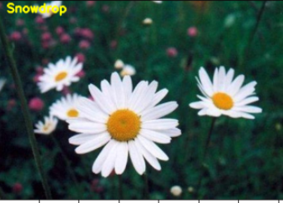
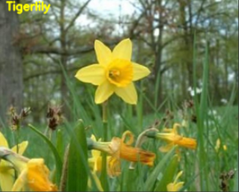
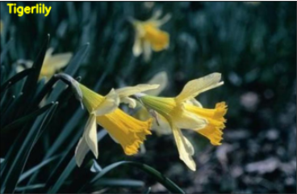
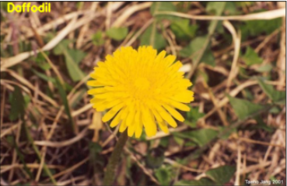
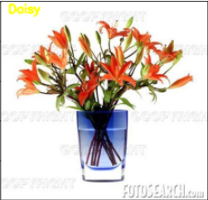
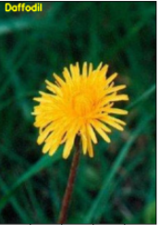
False predicted
(names of predicted flower are written on the top-left corner of each image )

Slide 19
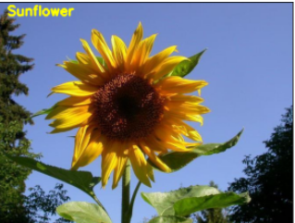
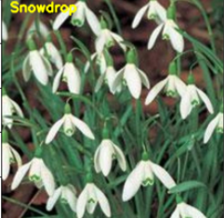
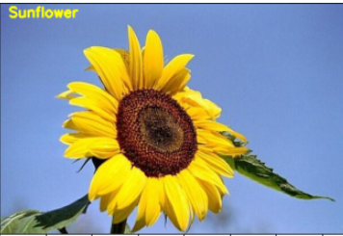
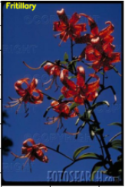
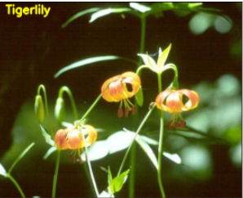
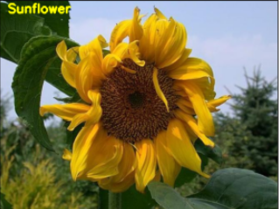
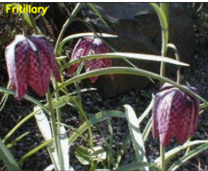
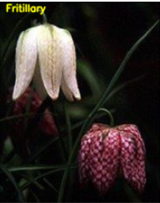
Truly predicted
(names of predicted flower are written on the top-left corner of each image )

Slide 20
Model is predicting the images with a good accuracy but this can further be improved by
We can use data augmentation to generate more images for each class so as to get variety among the dataset
Both the global and the local features can be used as features to train the model in a better way
CNN

Slide 21
Class-wize precision , recall and overall accuracy using logistic regression

Slide 22
ColisFoot
Precision: 0.82
Recall: 0.75
Daffodil
Precision: 0.83
Recall: 0.71
Daisy
Precision: 0.71
Recall: 0.71
Dandelion
Precision: 0.44
Recall: 0.67
Fritillary
Precision: 0.83
Recall: 1.00
Snowdrop
Precision: 0.78
Recall: 1.00
Sunflower
Precision: 0.40
Recall: 0.40
Tigerlily
Precision: 0.86
Recall: 0.55

Slide 23
Overall test Accuracy of the dataset (on test samples)
Total inputs: 60
Correctly predicted: 43
Overall Accuracy: 0.72

Slide 24
Confusion Matrix (LR)
 | ColisFoot | Daffodil | Daisy | Dandelion | Fritillary | Snowdrop | Sunflower | Tigerlily
ColisFoot | 9 | 0 | 0 | 2 | 1 | 0 | 0 | 0
Daffodil | 0 | 5 | 0 | 1 | 0 | 0 | 1 | 0
Daisy | 0 | 0 | 5 | 0 | 0 | 2 | 0 | 0
Dandelion | 0 | 1 | 0 | 4 | 0 | 0 | 1 | 0
Fritillary | 0 | 0 | 0 | 0 | 5 | 0 | 0 | 0
Snowdrop | 0 | 0 | 0 | 0 | 0 | 7 | 0 | 0
Sunflower | 0 | 0 | 1 | 1 | 0 | 0 | 2 | 1
Tigerlily | 2 | 0 | 1 | 1 | 0 | 0 | 1 | 6
AV
PV
AV : Actual values PV: Predicted values

Slide 25
Prediction on some random images (which are separated from the dataset before training)using Logistic Regression

Slide 26
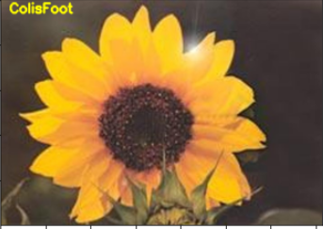
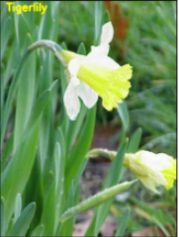
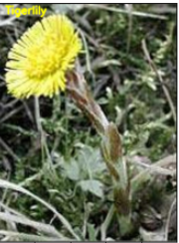
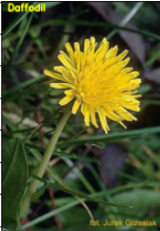
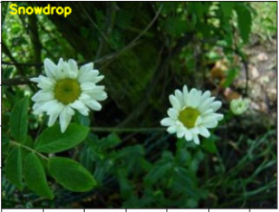
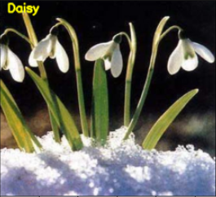
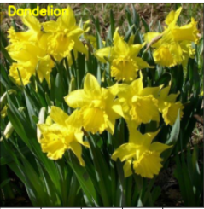
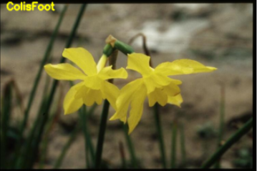
False predicted
(names of predicted flower are written on the top-left corner of each image )

Slide 27
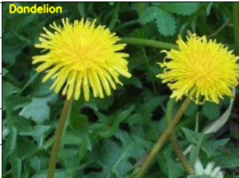
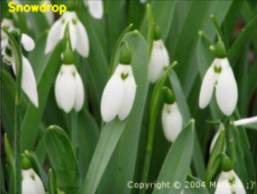
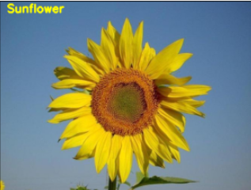
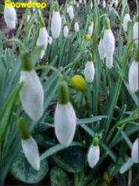
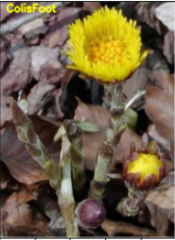
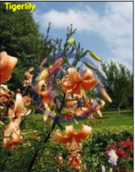
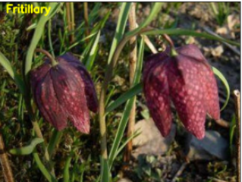
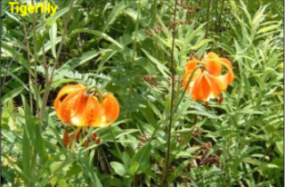
Truly predicted
(names of predicted flower are written on the top-left corner of each image )

Slide 28
The model is predicting the images with a good accuracy but it can be improved by:
Using the data augmentation technique to produce more images in each class so that we can get a variety of samples within each class
Combining global and local features and then training the model with these features can give a much more improved accuracy
By collecting more data in each class with different properties in each image

